Slide 1

Visión por Computador
Domingo Mery
Departamento de Ciencia de la Computación
Escuela de Ingeniería
Universidad Católica de Chile
Visual Transformers
[ Capítulo 3 ]

Slide 2
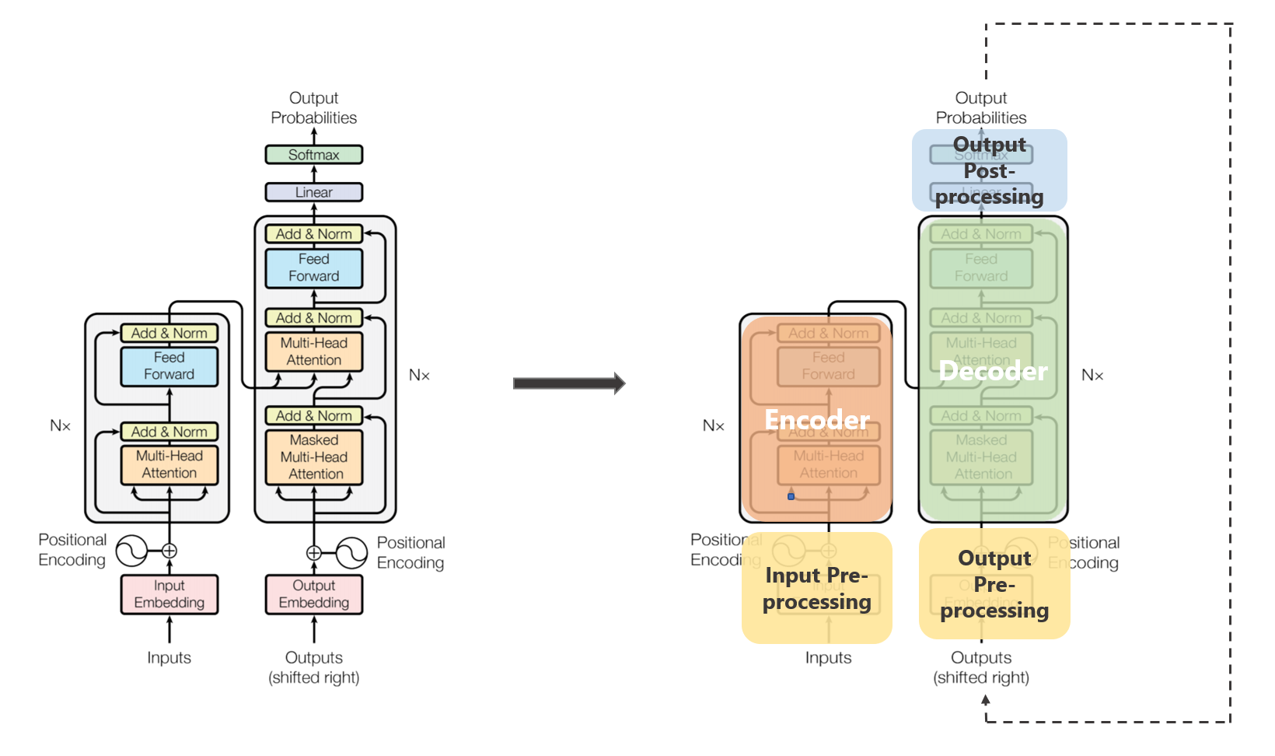
Transformers
Vaswani, Ashish, Noam Shazeer, Niki Parmar, Jakob Uszkoreit, Llion Jones, Aidan N. Gomez, Łukasz Kaiser, and Illia Polosukhin. "Attention is all you need." Advances in neural information processing systems 30 (2017).

Slide 3
Transformers
From https://towardsdatascience.com/transformers-89034557de14

Slide 4
Visual Transformer (ViT)

Slide 5
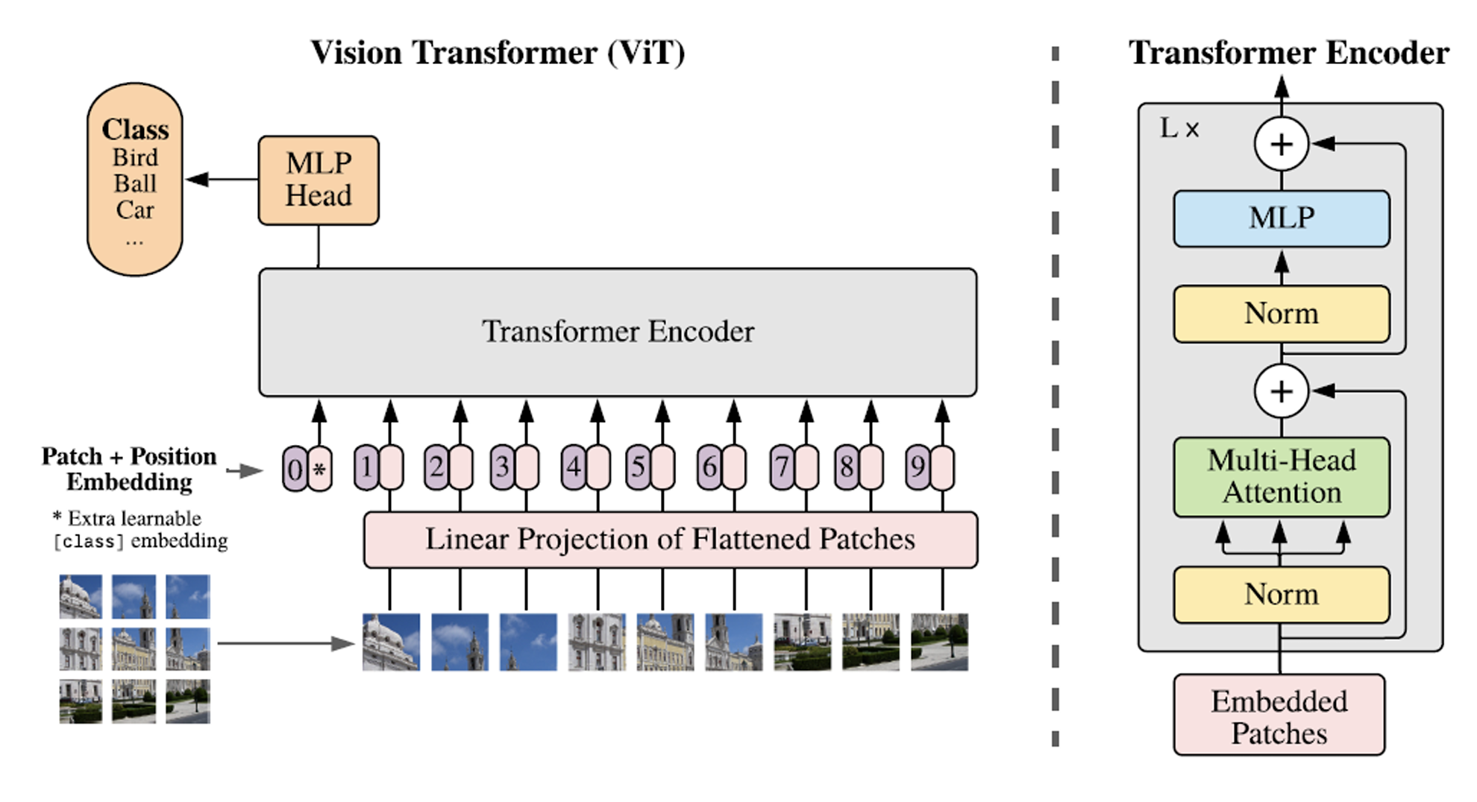
Visual Transformer (ViT)
Dosovitskiy, Alexey, Lucas Beyer, Alexander Kolesnikov, Dirk Weissenborn, Xiaohua Zhai, Thomas Unterthiner, Mostafa Dehghani et al. "An image is worth 16x16 words: Transformers for image recognition at scale." arXiv preprint arXiv:2010.11929 (2020).

Slide 6


Visual Transformer (ViT)
Example: ViT in Face Recognition

Slide 7

Visual Transformer (ViT)
48x48

Slide 8
Visual Transformer (ViT)
16x16

Slide 9
Visual Transformer (ViT)
16x16

Slide 10
Visual Transformer (ViT)

Slide 11
Visual Transformer (ViT)

Slide 12
Visual Transformer (ViT)

Slide 13
Visual Transformer (ViT)

Slide 14
Visual Transformer (ViT)

Slide 15
Visual Transformer (ViT)

Slide 16
Visual Transformer (ViT)
256x1x3

Slide 17
Visual Transformer (ViT)
256x1x3

Slide 18
Visual Transformer (ViT)
Red
256x1
Green
256x1
Blue
256x1
256x1x3
768x1

Slide 19
Visual Transformer (ViT)
768x1
256x1x3

Slide 20
Visual Transformer (ViT)
768x1
256x1x3

Slide 21
Visual Transformer (ViT)
16x16x3
768x1
256x1x3

Slide 22









Visual Transformer (ViT)

Slide 23
Visual Transformer (ViT)

Slide 24
Visual Transformer (ViT)
768x9

Slide 25

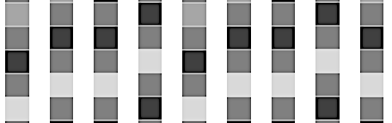


Visual Transformer (ViT)
Class
MLP
Transformer Encoder
PE
. . .
PE
+
+

Slide 26
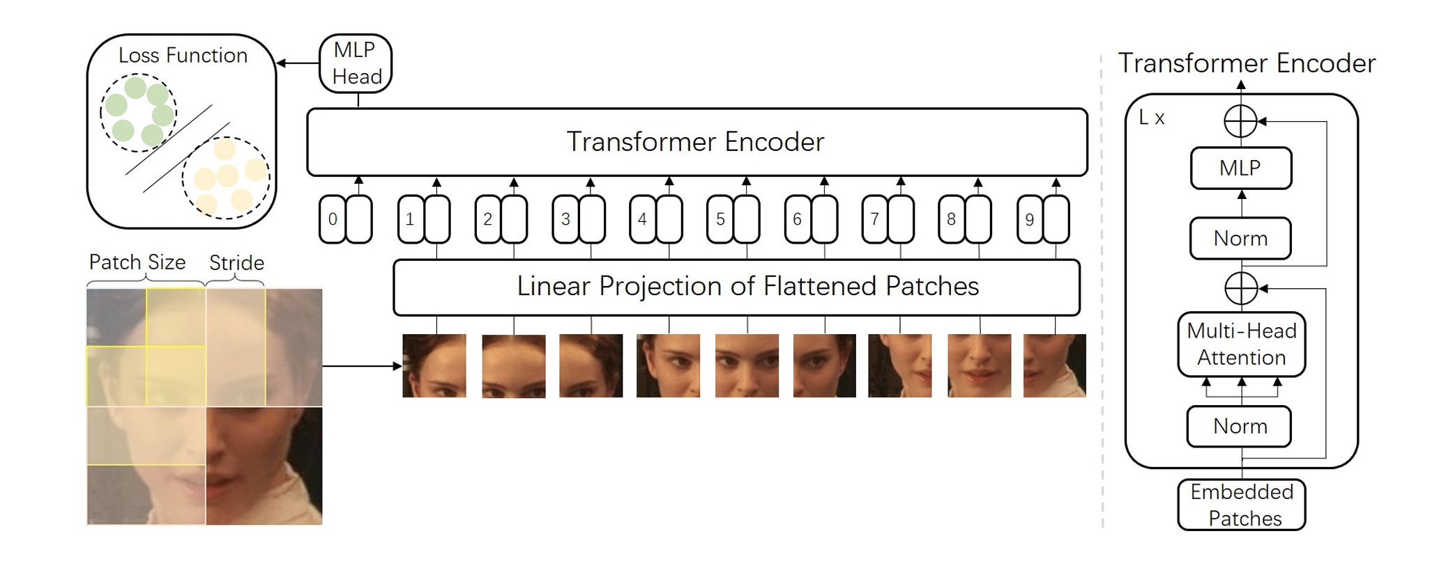
Visual Transformer (ViT)
Zhong, Y., & Deng, W. (2021). Face transformer for recognition. arXiv preprint arXiv:2103.14803.

Slide 27
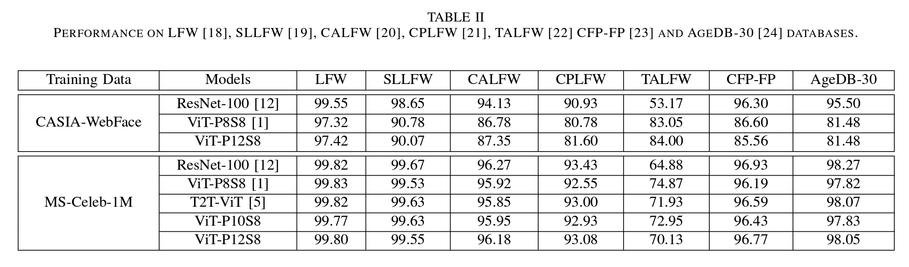
Visual Transformer (ViT)
Zhong, Y., & Deng, W. (2021). Face transformer for recognition. arXiv preprint arXiv:2103.14803.

Slide 28
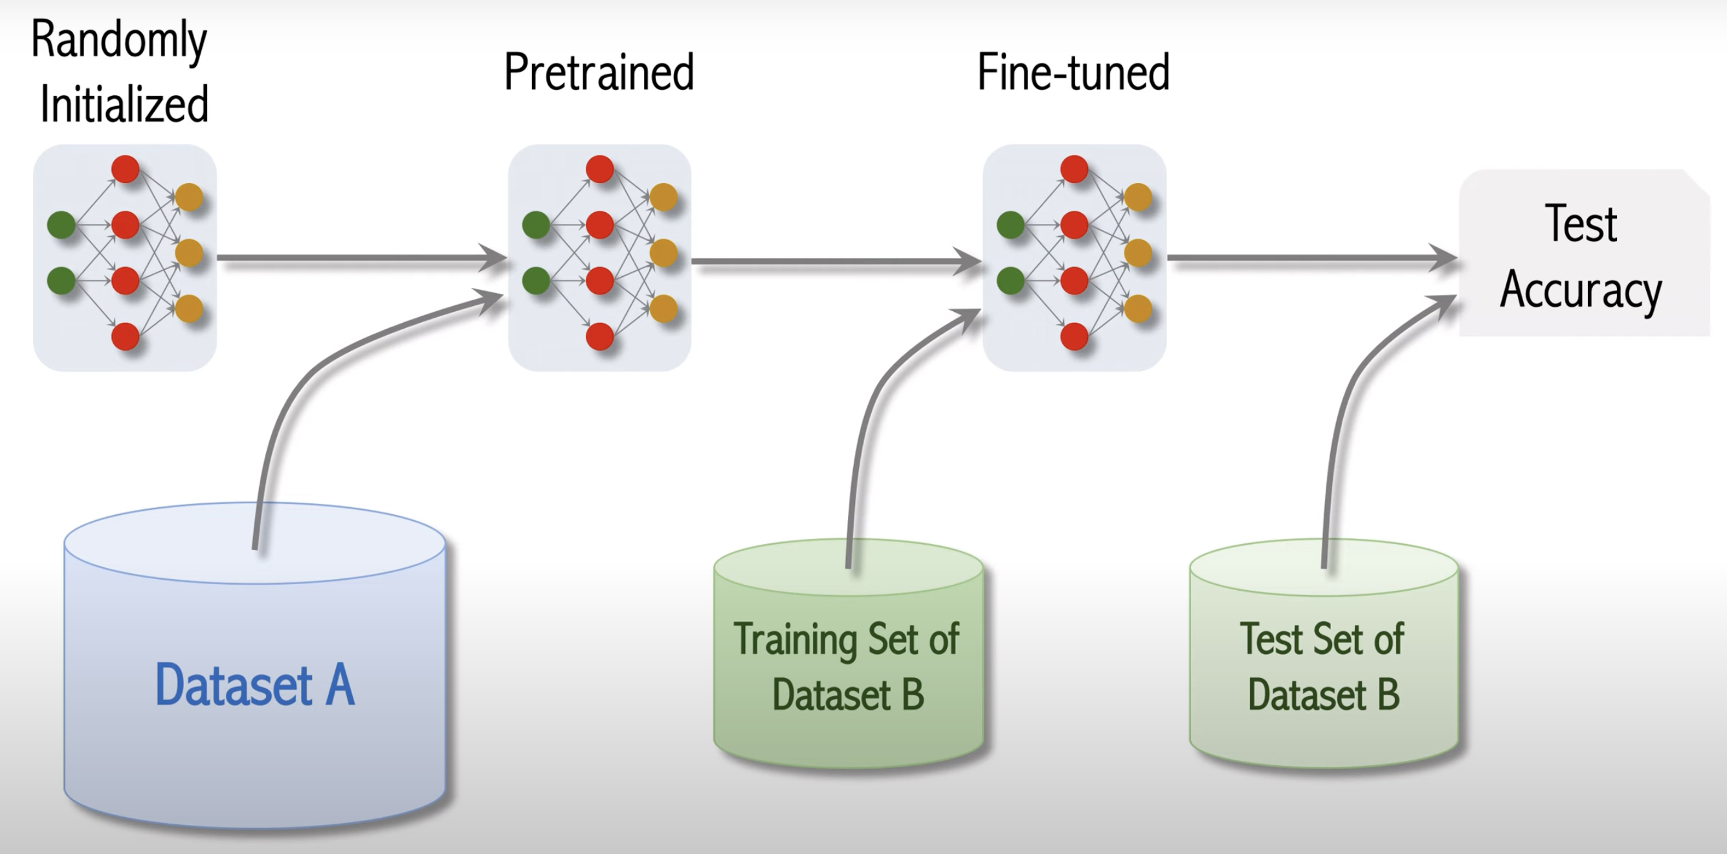
Visual Transformer (ViT)
Shusen Wang: Vision Transformer for Image Classification. https://youtu.be/HZ4j_U3FC94?si=plI9zvAIxx2eIYgq

Slide 29
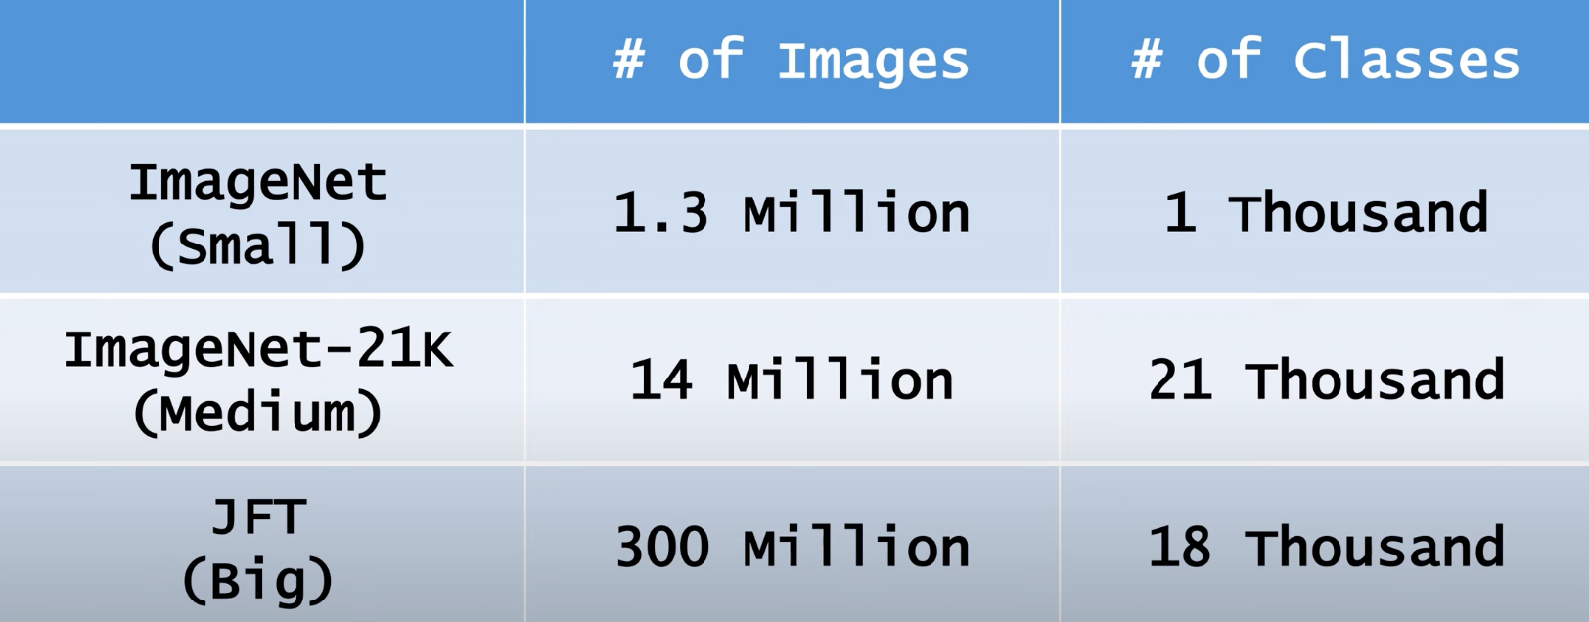
Visual Transformer (ViT)
Shusen Wang: Vision Transformer for Image Classification. https://youtu.be/HZ4j_U3FC94?si=plI9zvAIxx2eIYgq

Slide 30
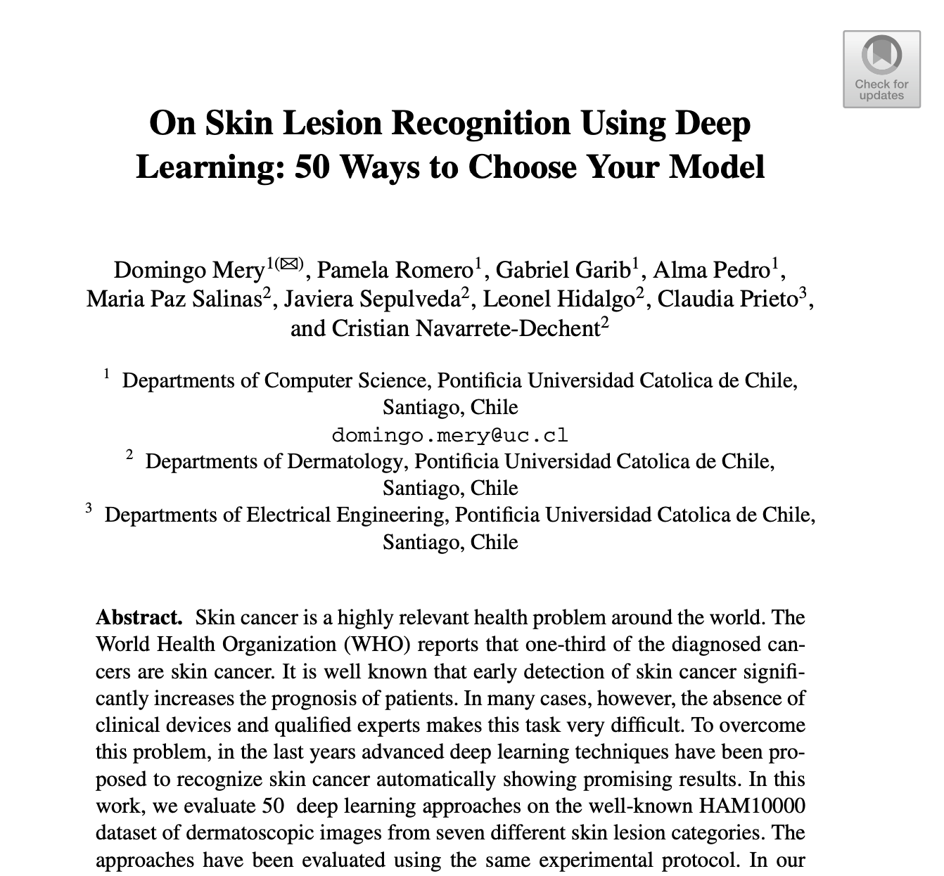
Visual Transformer (ViT): Example
Mery, Domingo, Pamela Romero, Gabriel Garib, Alma Pedro, Maria Paz Salinas, Javiera Sepulveda, Leonel Hidalgo, Claudia Prieto, and Cristian Navarrete-Dechent. "On Skin Lesion Recognition Using Deep Learning: 50 Ways to Choose Your Model." In Pacific-Rim Symposium on Image and Video Technology, pp. 103-116. Cham: Springer International Publishing, 2022.

Slide 31
Evaluated Methods
AlexNet
GoogleNet
ConvNet
VGG
ResNet
ResNeXt
DenseNet
SqueezNet
ShuffleNet
MobileNet
MnasNet
EfficientNet
ARLNET
ViT
Wide ResNet
50 models from
15 different architectures

Slide 32
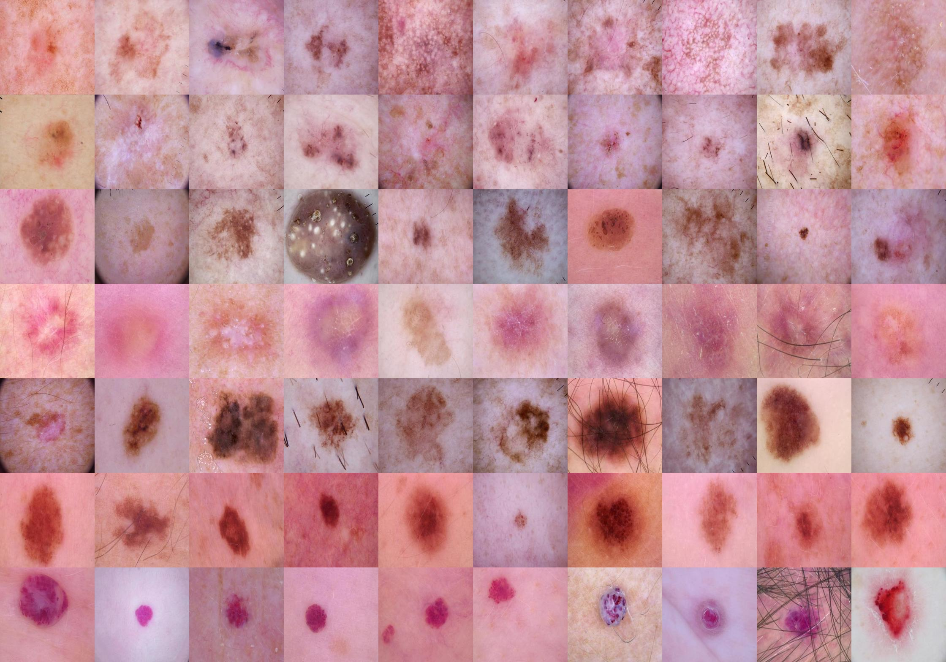
Class | Acronym | Name
0 | akiec | Actinic Keratosis
1 | bcc | Basal Cell Carcinoma
2 | bkl | Benign Keratosis
3 | df | Dermatofibroma
4 | mel | Melanoma
5 | nv | Melanocytic Nevus
6 | vasc | Vascular Lesion
Database
ISIC Dataset – HAM 10000

Slide 33
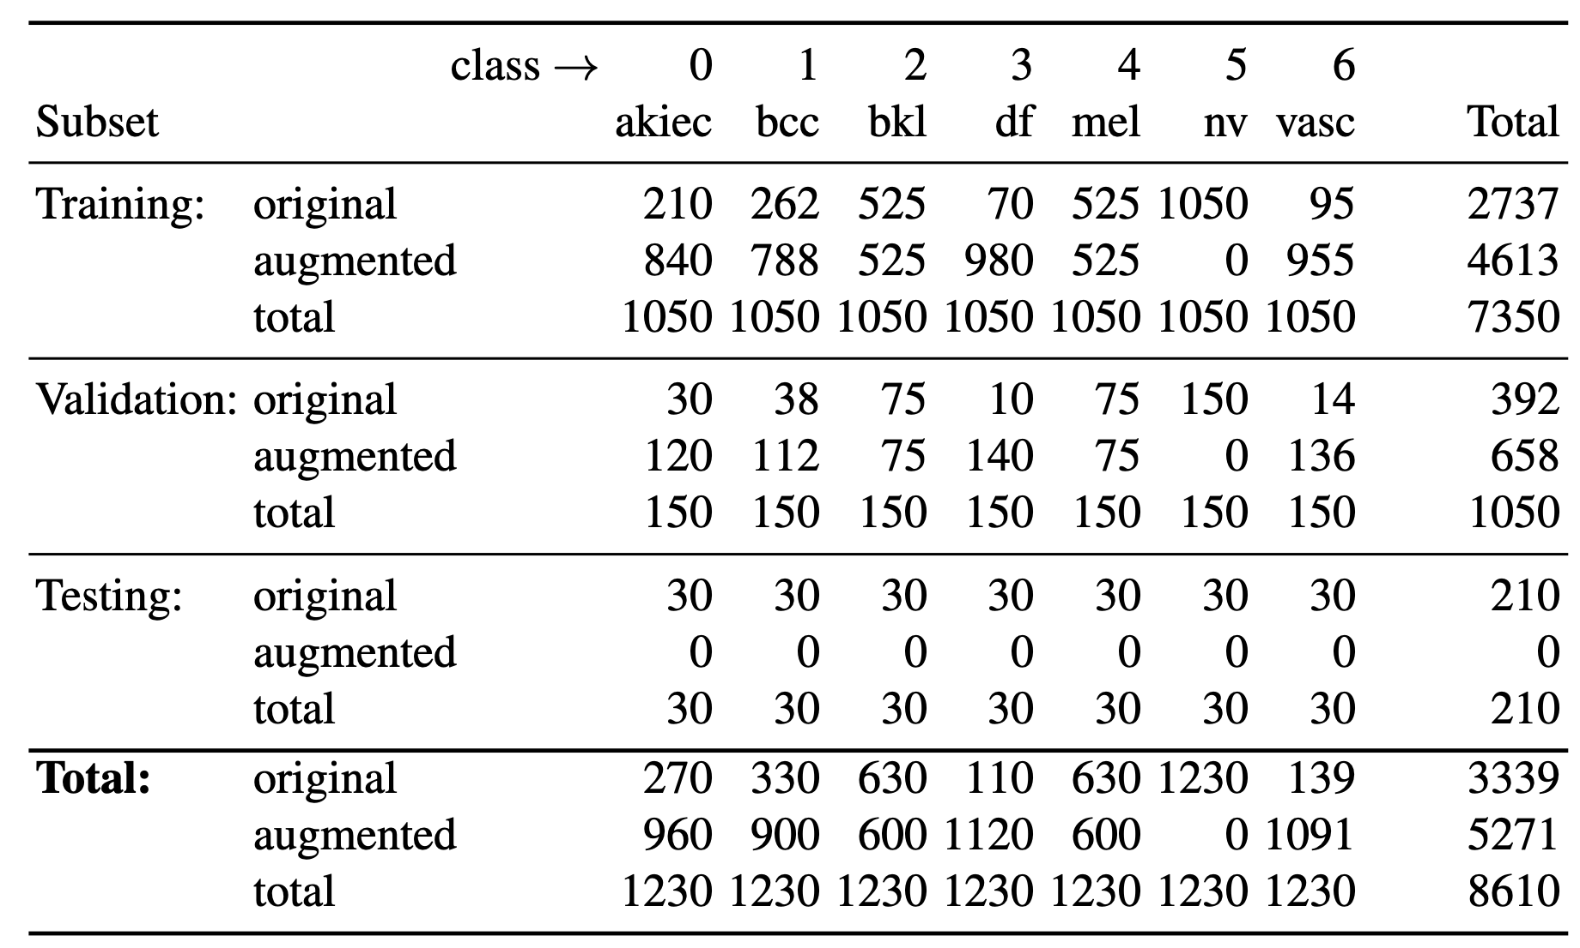
Number of images for training, validation and testing of each class

Slide 34
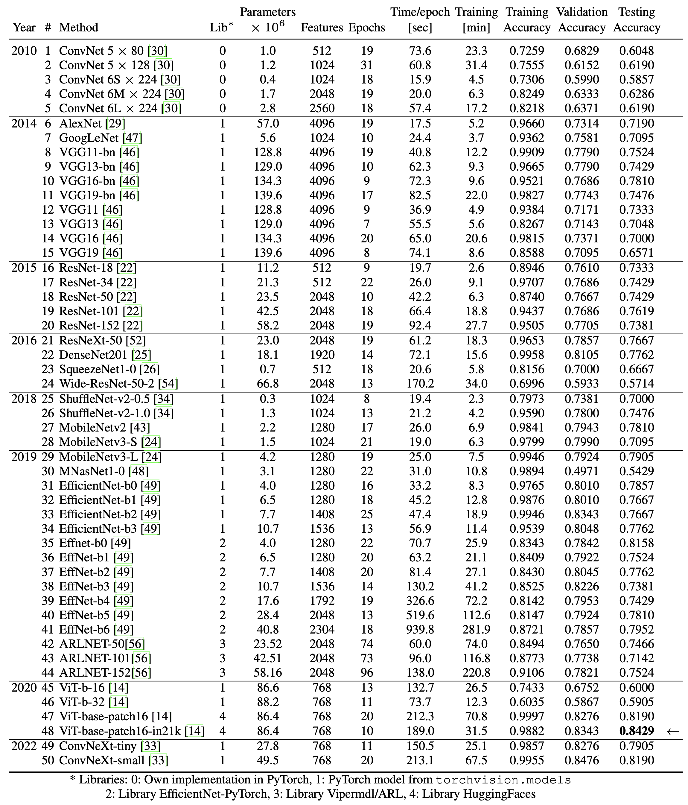
Results
for the
50 models

Slide 35
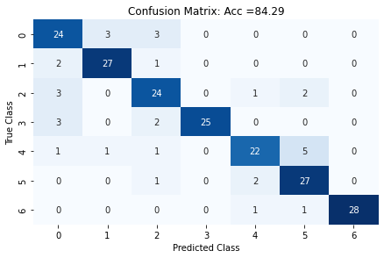
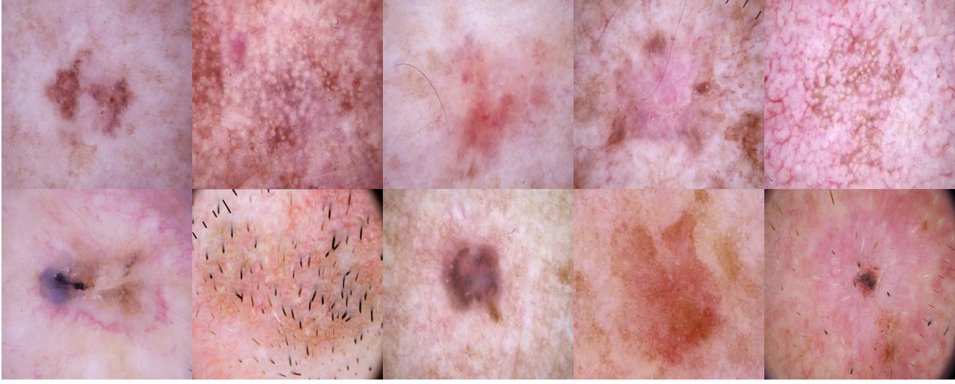
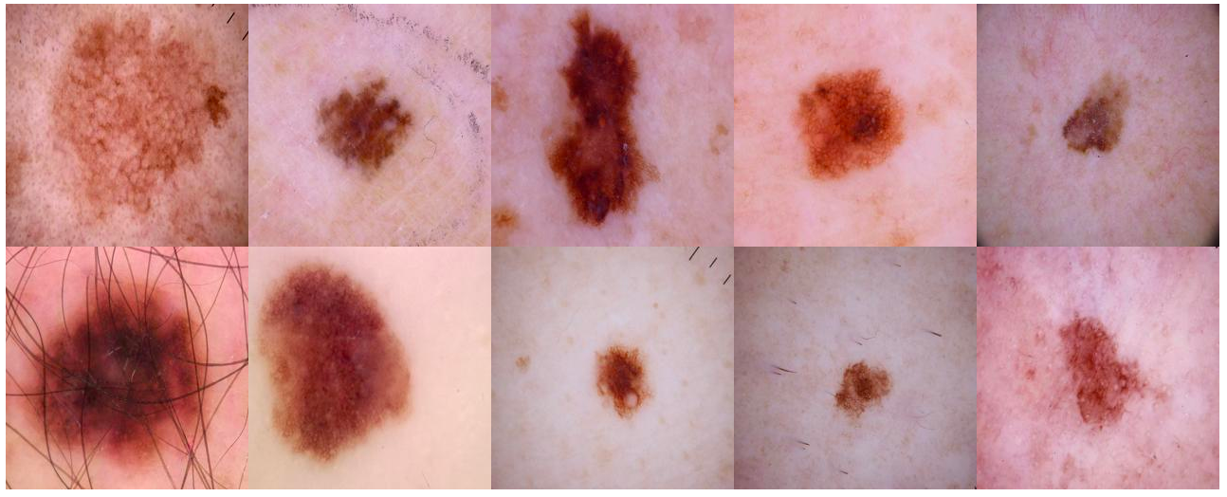
Confusion Matrix for Best Model (ViT)
Images classified as Class 0
correctly
classified
wrongly
classified
Images classified as Class 4
correctly
classified
wrongly
classified

Slide 36
Images classified as Class 0
correctly
classified
wrongly
classified
Images classified as Class 4
correctly
classified
wrongly
classified

Slide 37
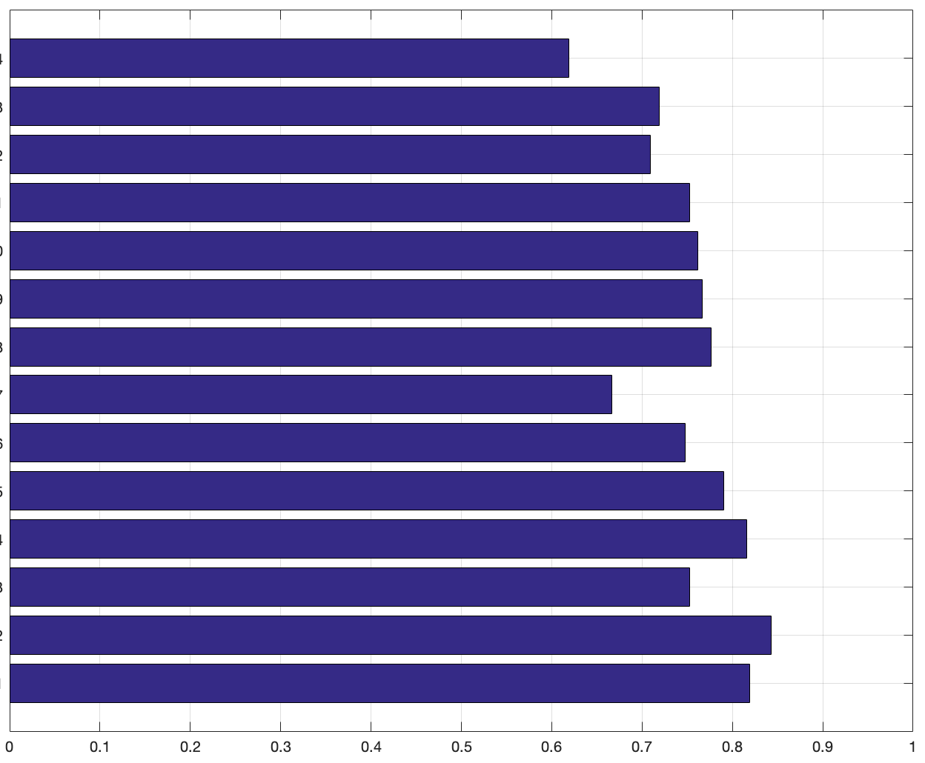
Accuracy on testing subset for each architecture
ConvNet
AlexNet
GoogLeNet
VGG
ResNet
ResNeXt
DenseNet
SqueezeNet
ShuffleNet
MobileNet
EfficientNet
ARLNET
ViT
ConvNeXt
0.6286
0.7190
0.7095
0.7524
0.7619
0.7667
0.7762
0.6667
0.7476
0.7905
0.8158
0.7524
0.8429
0.8190
2010
2014
2015
2016
2018
2019
2020
2022

